Slide 1

15th Jan
OptumRx – Delivery Transformation - 2018

Slide 2
Delivery Transformation - Scope
Delivery transformation is one of the key focus area for 2018
Need for closer alignment with agile delivery/engineering roles, as well as deeper technical talent to enable transformation
PROCESSES / METHODOLOGY
TOOLS / TECHNOLOGY
Delivery Process – to be better aligned with changing business requirements & quick response to business needs
Usage of tools to improve productivity / efficiency & enable a quicker & better delivery – Dev / Ops
PEOPLE
Align ourselves with engineering practices / role – prepare current talent pools to be able to align better to new process & tools

Slide 3
Delivery Transformation – Approach & Plan
Aligned to OptumRx Agile Transformation
90% work in
Waterfall model
Varying Release Cycle from 3-8 Months
15 Scrum Teams including 2 Independent Scrum team
Talent Transformation | 2. Engineering Org Model
3. Goals / MBOs | 4. Tools & DevOps
60% workforce practicing Agile
Time to Value goal in line with OptumRx MBO’s
25 Independent OGS Scrum Teams
Target Roles (EM, SM, TL & Engineers)
Assessment & Role Map
Individual Development Plan
Team Structure & Distribution – EM & SM roles @ US / OGS
Demand & Projection (SM & EM)
Scrum vs. Kanban
%age Agile Transformation
Time to Value
No. of Independent Scrum Teams
CI & CD
ATDD
Q1
Q2
Q3
Q4
Role Mapping & US / OGS Team Structure
Individual Development Plans
Hiring of Agile Coaches.
50% team OSAM trained
Engineering Practices, CI/CD & ATDD seeded
80 QE, 5 SMs & 10 EMs
50% team practicing Agile
15 Independent Scrum Teams
DevOps implementation
500 Engineers (150 QEs), 20 SMs & 20 EMs
25 Independent Scrum Teams
DevOps maturity including ATDD
OGS Delivery Transformation
Roadmap
250
Staff on Agile roles
350
Staff on Agile roles
500
Staff on Agile roles
600
Staff on Agile roles
Notes:
Total number -~ 600 (2/3rd Organization) would move to engineering role by end of CY2018
Out of which 160 resources as part of Independent Scrum Team (Delivery Team + SM)
Release Cycle (per team) – 270++ days
~150 people practicing Agile. Another 450 people on Agile by CY2018
Roles
3 SMs, 1 PO – Move to 20 SMs (transformation of 10-15 additional SMs) and X no of proxy PO.
Digital, PAS and RxLink (+ IRIS????)

Slide 4
Talent Transformation: Quarter - on - Quarter Plan
 | EOY 2017 | EoQ1 2018 | EoQ2 2018 | EoQ3 2018 | EoQ4 2018 | EOY 2018
Dev Engineers | 86 | 203 | 291 | 346 | 362 | 362
Quality Engineer | 29 | 76 | 115 | 139 | 147 | 147
Tech Lead | 7 | 15 | 23 | 29 | 30 | 30
Scrum Master | 3 | 6 | 11 | 16 | 18 | 18
Engineering Manager | 5 | 11 | 16 | 20 | 20 | 20
Product Owner | 1 | 2 | 2 | 2 | 2 | 2

Slide 5
Delivery Transformation Approach
Aligned with broader OptumRx Agile transformation agenda (please see on next page)
15 scrum teams are in progress
Roughly 100 New Scrum Team across ~50 work groups
Quarter on Quarter Plan
Finalize Engineering Roles along with onshore partners
Role Mapping & alignment to key roles like Engineers, Tech Lead, Engineering Manager, Scrum Master, SME, PO etc..
Assessment of current SG 27, 28 & 29 against Delivery transformation needs
Org / Team structure working with onshore leaders
No. of total scrum teams & distribution across US & India
Demand vs. projection of roles
Reskill vs. Hire
Scrum vs. Kanban (SSMO)
Notes:
Success Criterion: Outcome based - ‘Targeted available role is filled’ & overall Competency enrichment

Slide 6

OptumRx Agile Transformation Roadmap
JAN
FEB
MAR
APR
MAY
JUN
JUL
AUG
SEP
OCT
NOV
Charlie Goodall
5
2
5
2
Jim Park & Dan Zerafa
1
3
11
9
3
Hank Schmitz
10
1
4
2
2
3
Jack Haggerty
1
7
3
7
3
Sunil Kripalani
5
6
4
3
SCRUM Teams
17
16
7
26
8
2
16
6
Agile Coaches
8
8
3
13
4
1
8
3
Note: 1 coach per two teams. Experienced coach may coach 3 teams.

Slide 7
Talent Transformation
Matt Mosher

Slide 8
Talent Transformation Progress and Approach
Current State Assessment
Assess current role, experience & competency level
Mapping with Engineering Roles
Identified individual development plan for all the Engineering Roles
Identified target month for agile transformation aligned as per the roadmap
Future State Assessment
Analysis of agile readiness index (Trained =1 : Intermediate =2 : Expert=3) based on the development plan and opportunities given
Assess agile transformation status after execution of 1 PI
Execution
Individual Development Plan to transition target Engineering role
Two step approach to fill gaps w.r.t. technical, functional, process & soft skills
Minimum basis training based intervention to be able to work in agile
Detailed training plan to move in to full stack agile development role
Final Maturity Assessment
Detailed training completion
Experience of atleast 1 complete PI

Slide 9
Delivery Transformation – Roadmap for Talent
 | Initialization (by 30th Dec) | One (1) Month (Planning) | 2- 3 Months (Execution L1) | 3-6 Months
Talent (People) | Plan & Approach Ready | 1. Finalize Engineering Roles & Demand/Outlook for CY2018 | Learning Maps Drawn for all Engineering Roles | Re-Alignment of resources to New Roles (If required)
 |  | 2. Role level Demand Vs Supply gap | 2. Execution of Competency Development Plan for 1st set of Talent pool | Next set of Talent pool identification (Q3 onwards on roadmap)
 |  | 3. Assessment of all Rx Colleagues & Mapping to Target Role – In Progress | 3. Initiate new Roles hiring (basis CY2018 Demand/Outlook ) on new Learning Maps – aligned to Delivery Transformation / Roadmap
 |  | 4. Individual Development Plan creation for each identified resource (Role – wise) (Guidelines being drawn)
 |  | 5. Firm up overall Initiative funding (Investment Resources, External/ Internal Trainings)
Outcome/ Deliverable | Approach & Plan | Individual Development plan (In MAP) Required Approvals | 1. 1st Talent pool set ready

Slide 10
OptumRx Role Mapping (first cut)
Row Labels | 20 | 24 | 25 | 26 | 27 | 28 | 29 | 30 | Grand Total
Dev | 6 | 39 | 192 | 213 | 64 | 26 | 4 | 1 | 545
QA | 7 | 23 | 116 | 84 | 19 | 10 |  |  | 259
SSMO | 2 | 5 | 50 | 55 | 8 | 4 |  |  | 124
Grand Total | 15 | 67 | 358 | 352 | 91 | 40 | 4 | 1 | 928
~85% population (SG 24 to SG 26) will map to engineer role
~70-80% of SG 27 should map to Tech Lead / Functional SME role
SG 28 to be mapped to Engineering manager / Scrum Master role

Slide 11
Roadmap – Dan Zerafa (Sample)
Notes:
Sample

Slide 12
Transformation Plan – PBM Services - Dan Zerafa (Sample)
 |  |  | Planned Roles - No. of resources at OGS
PBM Services | No. of Work groups | No. of Scrum Teams | Engineers (Dev / QA) |  | Tech Lead | Scrum Master | Eng Mgr | SME | PO
Q4, 2017 | 2 | 3 | 7 | 4 | 1
Q1, 2018 | 4 | 4 | 23 | 14 | 3 | 1 | 2
Q2, 2018 | 6 | 11 | 39 | 21 | 4 | 3 | 2
Q3, 2018 | 6 | 9 | 23 | 14 | 3 | 2 | 2
Q4, 2018 | 3 | 3 | 8 | 4 | 1 | 1
* Indicative at this time

Slide 13
DevOps CI > CD
Matt Mosher

Slide 14
DevOps - 30-60-90 Days Plan
30 Days
60 Days
90 days
Identification of Technology Spread
Categorization of projects under Technology stack
Finalization of Assessment model
Adoption of Assessment model to projects
Identification of projects for POC
Identification of SPOC's for the selected projects
Project - 1
Review the assessment score
Identify drivers rated in 3 & 4 category
Perform the gap analysis
Identify Open Source DevOps tools for adoption and automation
Perform POC to implement tools
Check performance post implementation
Revisit assessment model for latest score
Derive ROI

Slide 15
DevOps Roadmap and Milestones
Road Map
ROAD MAP |  | 30 day plan |  |  |  | 60 day plan |  |  |  | 90 day plan
Phases | Tasks | WK1 | WK2 | WK3 | WK4 | WK5 | WK6 | WK7 | WK8 | WK9 | WK10 | WK11 | WK12
Business IT Alignment | Identify Business goals
 | Establish a program governance
Planning and Initial Assessment | Identification of DevOps assessment model
 | Identify technology stack & tools
 | Identify and establish DevOps metrics
Pilot an Application | Identify and initiate pilot application
 | Form cross functional devOps team(Dev, QA, Operation)
 | Examine value stream for constraints and bottlenecks
 | Adoption of continuous integration process/tools
 | Automation in Quality Assurance process
 | Automation of deployment process
Iterative adoption | Measure progress through metrics
 | Measure against business goals
Key Milestones
# | Milestones | Week of closure
1 | Finalization of Goals and Assessment model | Week - 2
2 | Pilot app & value stream bottlenecks identified | Week - 6
3 | Completion of Continuous Integration (CI) and QA automation | Week - 8
4 | Completion of Continuous Deployment automation | Week – 11
5 | Business value generated | Week - 12

Slide 16
Engineering Role(s) Map
Matt Mosher

Slide 17
Proposed Role Mapping
# | Current Role | Target Role
1 | Dev/ QA/ Automation Tester | Engineer
2 | Team Lead/ Dev Lead/ QA Lead/ SA Lead | Tech Lead
3 | Business Analyst/ UAT | Product Owner
4 | Project Manager | SCRUM Master
5 | Delivery Lead / Dev Manager | Engineering Manager
6 | Release Manager | Release Train Engineer (RTE)
7 | Delivery Manager | Solution Train Engineer
8 | Portfolio Lead/ Delivery Director | Portfolio Lead/ Delivery Director
9 | System Architect | System Architect
10 | Enterprise Architect | Enterprise Architect
11 | PMO, Project Sponsor, Sr. Management | Program Portfolio Management
12 | Functional SME | Travellers / Functional SME
13 | UI/UX (Optional) | UI/UX (Optional)
14 | System Testing Team | System Team (Optional)
15 | CI / CD Team / Deployment Team | DevOps (Optional)
16 | Business Owners | Product Manager
17 | Business Sponsors | Business Sponsors

Slide 18
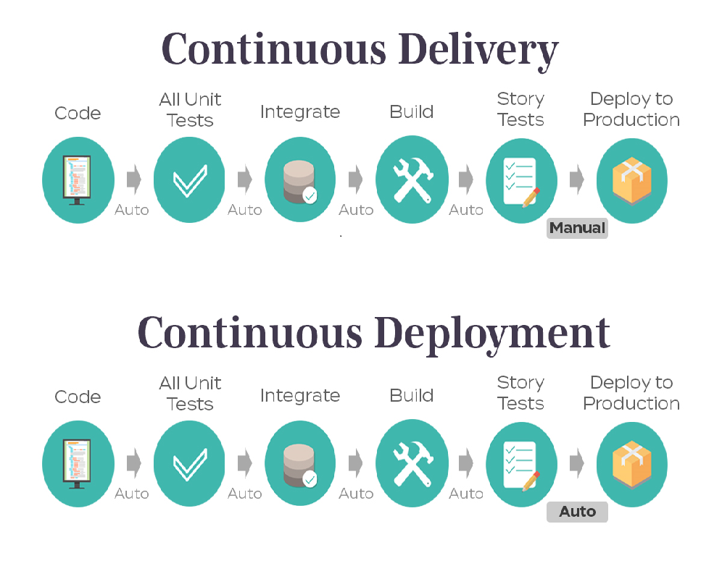
What do I need – Engineer (Foundation)
“Expectations and Hands-on role play”
Technology Stack
Knowledge of development language
Understand E2E Application functional flow
Work in agile team
Have the ability to build/ test a user story
Understand customer and business needs
Understanding of development language
Able to help in testing of product in controlled, real situations before going live
Trainings
Agile Essentials | OSAM
Testing process & Test Planning | CA Agile tool for end to end
Basic knowledge of DevOps Tools and CI-CD
Other Skills
Communication | Team work
Defect management Tracking
Domain
Basic Knowledge of PBM domain

Slide 19
What do I need – Engineer (Advance)
Technology Stack
Knowledge of development language( Services an UI)
Knowledge of Database
APIs | Version Control(SVN,CVS,GIT)
“Expectations and Hands-on role play”
Work in agile team
Expertise in development language
Understand application flows – In-depth knowledge of what is being developed
Have the ability to design/ build/ test a full vertical slice of a user story.
Understand customer and business needs
Should involve in end-to-end 1 PI.
Able to help in testing of product in controlled, real situations before going live
Able to build Solutions using relevant CI- CD tools
Trainings
Quality Engineering Processes | Requirements Traceability & Test scenarios / Test suits
Acceptance Test Driven Development | CI/CD tools - Jenkins, XLDeploy, GitHub
CA Agile tool for end to end | Performance Testing tools – Load runner and Jmeter
Understand and build solutions using Dev Tools and CI-CD
Other Skills
Written/Verbal Communication | Team work
Analytical and problem-solving skills | Defect management Tracking
Domain
E2E Knowledge of Functional flow
PBM 202 | HDP

Slide 20
What do I need – Engineer (Full Stack Developer)
Technology Stack
Application technology Stack ( technology layers – Services and UI)
Knowledge of Testing Tools and Framework
Database and Development language
APIs | Version Control(SVN,CVS,GIT)
“Expectations and Hands-on role play”
Work in agile team
Understand application flows – In-depth knowledge of what is being developed
Have the ability to design/ build/ test a full vertical slice of a user story (including automated unit and functional/acceptance test).
Understand customer and business needs
Expertise in development language and should be able to provide technical inputs
Able to help in testing of product in controlled, real situations before going live
Should involve in end-to-end 1 PI and take end to end accountability for design/build and test
Able to build Solutions using relevant CI- CD tools
Participate in the test automation - Execute and Maintain existing automation
Trainings
Quality Engineering Processes | SSMO Process
Tools Knowledge | Test Automation Process (Selenium, etc.)
CA Agile tool for end to end
Expert in building and automate solutions using Dev Ops Tools and CI-CD
Other Skills
Written/Verbal Communication | Team work
Analytical and problem-solving skills | Defect Management Tracking
PBM Domain
E2E Knowledge of Functional flow and overall Architecture
PBM 202 | HDP

Slide 21
Trainings for Engineer (Full Stack Developer)
Training | Specific Area
SSMO Processes - Day 1 | SSMO Orientation
SSMO Processes - Day 2 | Incident Management Process
SSMO Processes - Day 2 | Warroom process (what is war room, how to open war room, understanding of war room processes, roles and responsibilities)
SSMO Processes - Day 2 | War room notification process & High Priority Incident Notificatio Process
SSMO Processes - Day 3 | Problem Management Process
SSMO Processes - Day 3 | Change Management Processes
SSMO Processes - Day 4 | Tableau Metrics
SSMO Processes - Day 4 | Health Assessment Dashboard
SSMO Processes - Day 5 | Offshore restrictions
SSMO Processes - Day 5 | Peak season readiness
Quality Engineering - Day 1 | Overall testing process & Test Planning
Quality Engineering - Day 1 | Requirements Traceability & Test scenarios / Test suits
Quality Engineering - Day 2 | System & Regression testing processes
Quality Engineering - Day 2 | UAT testing processes
Quality Engineering - Day 3 | Performance Testing
Quality Engineering - Day 4 | Acceptance Test Driven Development
Quality Engineering - Day 5 | Test Automation Process (Selenium, etc.)
Tools - Day 1 | Basic UNIX commands
Tools - Day 2 | Service Now
Tools - Day 2 | TWS & Job Monitoring
Tools - Day 2 | Enterprise Service Catalogue
Tools - Day 3 | Understanding of Monitoring tools - Splunk, HPBSM, New Relic, Dynatrace, etc
Tools - Day 4 | Testing tools & frameworks
Tools - Day 4 | Performance testing tool - Laodrunner and Neoload
Tools - Day 5 | CA Agile tool for end to end
Tools - Day 5 | Understanding of CI/CD tools - Jenkins, XLDeploy, GitHub

Slide 22
What do I need – Tech Lead
Technology Stack
Application technology Stack ( technology layers – Services and UI)
Knowledge of source/version Control(SVN,CVS,GIT)
Knowledge of Database
Knowledge of testing tools and framework
“Role Expectations and Hands-on role play”
Work in agile team
Define best practices
knowledge of software development processes and procedures to understand his team needs
Understand customer and business needs
Expertise in development language
Identifying and owning architectural and other technically based risk, escalating to the Project Manager as appropriate
Tech Lead spends 80% of time on engineering activities and 20% on people management.
Contribute to design and code Reviews. Should review at least 10 stories and come up with feedback
Accountable for the delivery outcome.
Help team or individual to clarify their technical queries .
Trainings
OSAM | CA Agile tool for end to end
Performance Testing tools – Load runner and Jmeter | Architecture & Design Patterns
Acceptance Test Driven Development
Expert and build solutions using dev Ops tools and CI-CD
Other Skills
Proactive Communication | Analytical and Problem solving
Team Work
Domain
Dependent application knowledge and their integrations
E2E Knowledge of Functional Areas and over all architecture

Slide 23
QE – Foundation Level
“What do I need to be at QE Foundation level?”
Development Language
Java | VBScript
Test Automation Tool
Rational Functional Tester | HP UFT
Selenium | Cucumber
Perfecto / Appium | SOAP UI / API Test
Cyara | Ab-initio
Have knowledge on one of topics from each areas
“Role Expectations and Hands-on role play”
ALM Tools
HP ALM | Rational CLM
CA Agile Central / Rally
Engage early in development lifecycle
Understand Agile concepts
Understand application flows – In-depth knowledge of what is being tested
Participate in the test automation - Execute and Maintain existing automation
Develop simple automation scripts
Understand and identify test data needs
QA Processes
OATS | Risk based Testing
OSAM – Mandatory
PBM Domain
PBM 101 | HDP
Formulary | Rxclaim
Clinical

Slide 24
QE – Practitioner Level
QE - Practitioner
“What do I need to be at QE Practitioner level?”
Development Language
Apply development language learnings
Continuous Automation Tool
Apply Test Tool Learnings
Maven | Test NG
Jenkins | Virtualization/ Dockers
Cucumber | LeanFT
On the job and class room learnings
Apply Foundational level learnings - complete 2 test automation development project (~100 test scripts)
Learn application technology stack
Learn continuous automation tools
Technology Stack
Application technology Stack ( technology layers)
APIs | Jobs
“Role Expectations and Hands-on role play”
Processes
ATDD | BDD
Agile Metrics
Work in agile team
Engage early in lifecycle. PI Planning, Story writing, Acceptance criteria definition
Understand complex application flows
Pair working – Dev and QE to develop In-sprint and continuous automation
Basic debugging – application log analysis, job runs etc.
PBM Domain
PBM 202 | E2E functional flows

Slide 25
QE – Expert Level
QE - Expert
Development Language
Apply development language learnings
“What do I need to be at QE Expert level?”
Continuous Automation Tool
Apply Test Tool Learnings
Apply Continuous Automation tool Learning
Automation Frameworks
Strong knowledge on One or more test automation tools
Strong knowledge on application architecture
Learn Developing and maintaining frameworks
Technology Stack
Application technology Stack ( technology layers)
“Role Expectations and Hands-on role play”
Processes
Test Strategy | Test Env Management
Test Data Management | E2E – Enterprise Test
Test Pyramid / Strategy definition
Tool selections and Automation framework development & Setups
Continuous automation implementations
Integrating test automation with CI pipeline
Define best practices
Mentoring and coaching foundational and practitioner QEs
PBM Domain

Slide 26
What do I need - Scrum Master
Agile Framework
Scrum | Kanban
XP | Lean
“Role Expectations and Hands-on role play”
Understand Agile concepts
Engage early in lifecycle. PI Planning, Story writing, Acceptance criteria definition
Basic knowledge of software development processes and procedures to understand his team needs.
Help team or individual to clarify goals and actions to achieve them.
Able to remove the impediments for the scrum team
Arranged daily stand-up meetings, facilitate meetings, schedule meetings, demo and decision-making processes in order to ensure quick inspection and proper use of adaptation process.
Helps product owner to make the product backlogs in good shape and make them ready for the next sprint.
Trainings
OSAM | CA Agile tool for end to end
Impactful Communication | Scrum Master
Acceptance Test Driven Development
Expert in Agile concepts and their execution
Other Skills
Proactive Communication | Presentation Skill
Risk and Issue management | Team work
Analytical and problem-solving | Defect management Tracking
Agile Metrics(Burndown , EVC etc.
Domain
E2E Knowledge of Functional Areas
PBM 101 | HDP
Formulary | Rxclaim
Certifications( Good to Have)
PSM/CSM

Slide 27
What do I need – Product Owner
Agile Framework
Scrum | Kanban
XP | Lean
“Role Expectations and Hands-on role play”
Trainings
OSAM | CA Agile tool for end to end
Impactful Communication
Understand Agile concepts
Engage early in lifecycle. PI Planning, Story writing, Acceptance criteria definition
Basic knowledge of software development processes and procedures to understand his team needs.
Understand the business, the customer, and the technical capabilities
Define the business vision for the project
Communicate and promote the business vision to all interested parties
Monitor progress of the project in line with the business vision
Agile Techniques and Processes
Continuous Integration | ATDD/TDD
Good grasp of the key technical pieces | SDLC
Other/Business Skills
Communication/Presentation skills | Prioritization Skills
Risk and Issue management
Domain
Application knowledge and overall Architecture
E2E knowledge of Business scope and Product lifecycle
Certification ( Good to Have)
CSM | CSPO

Slide 28
What do I need – Engineering Manager
Technology stack
Understand technical landscape stack and current technologies available
“Role Expectations and Hands-on role play”
Trainings
OSAM | Java/J2ee
LOB and Cross LOB Overview | Architecture & Design Patterns
Impactful Communication | Managing Development
Knowledge of software development processes and procedures to understand his team needs
Manage multiple scrum teams.
Communicating with senior management and the project governance authorities
Monitoring progress against the baselined project plans
Get engaged in feature walkthrough, grooming, capacity planning, story sizing, scoping, sprint demo, rally reporting (burndown charts,) etc.
Participate in PLM activities
Should come up with migration approach and suggestions“
Should own end-to-end delivery for 1 PI.
Communicate Sprint Planning, Release Planning, Risks effectively to stake holders
Facilitates and guides the work of all of the Sprint commitment and Features delivery. Provides technical and domain specific support to team. Helps team in spotting challenges early and re-plan OR re-prioritization.
Nice To Have :
Participate in design, architecture review and come-up with at least one suggestion in following areas
Performance optimization feedback
Down stream and up-stream integrations optimization
Minimizing production outages
Processes
OSAM | SDLC
ATDD | TDD/BDD
Application over all architecture | Integration approach followed for up-stream and down-stream applications
Other Skills
Written/Verbal Communication Presentation skills
Decision Making and Leadership skills
Knowledge of Project Management , Documentation and Process Improvement
Domain
Dependent application knowledge and their integrations
E2E Knowledge of Functional Areas

Slide 29
Progress Updates
Matt Mosher

Slide 30
Delivery Transformation – Status Update
Pillars | Status Update | Challenges &Support Required
Talent Transformation | Role Mapping & US / OGS Team Structure X% role mapping complete. Discussions with Partners – in progress Agile Readiness : OSAM & SM training Coordination with Agile coaches – in progress. OSAM Target for Q1 – 150 . 55+ staff trained. 1 more batch in Jan’18 planed. Status – Green Scrum Maters nominations received. Training (1 day) to be planned Individual Development Plans Dependency on Role mapping. Target completion date – 31st Jan’18. Hiring of Agile Coaches – in progress. | Support required from FMS and SPOCs. Activity in Red – On critical path IDP for new roles: Status Yellow – Dependency in point #1 above Agile Coaches – At risk. Hiring from Market may impact Agile transformation roadmap
QA-QE | 35% QE penetration against 80% QE foundation targeted by Q1’ 18 Trainings complete till now - CoreJava, VBScript, PBM. (~65+ staff trained) Trainings in-progress - Selenium and RFT
Tools & DevOps | DevOps Transformation Road map for DevOps transformation as 30-60-90 days plan in place. Identified Pega and iSeries tracks as probable selects for POC. Current DevOps assessment in progress for the above tracks. | None for now
Notes:
Success Criterion: Outcome based - ‘Targeted available role is filled’ & overall Competency enrichment

Slide 31
Executive Summary
Delivery Transformation
Alignment with Agile Roadmap – In progress
Next Steps:
Quarter on Quarter plan (per latest road map) for Agile roles for all Portfolios
Ensure OSAM training for all portfolios
Role Mapping for remaining 10% roles
Individual Development Plan to be defined
Plan for SSMO folks
Talent:
Agile:
DevOps:
Sirisha
Amit/ Sriram.
Bhawna/ Manoj.
Status:
84% staff (~800 out of 959) will be mapped to Engineer role (Grade 26 or below)
~ 5-6% staff expected to aligned to Tech Lead /SME roles (Grade 27)
Role Definition for 5 Key roles drafted
Next Step
Mapping for other 10% staff by respective FMs (like new target roles SM,PO, Engineering Manager) )
Status:
28% OGS Rx resources OSAM trained (680+ are yet to be trained)
Jan & Feb’18 OSAM training plan is being firmed up basis revised roadmap
Next Step
Firm up OSAM Training plan for Q1/Q2
Nominate team members for sessions basis the Agile Roadmap
Status:
Application Assessment model is being finalized
Next Step
Identify key applications in scope for different technology landscape
Application assessment to begin

Slide 32
OptumRx Agile Transformation - Master Scorecard
“Agile” Awareness Survey
OSAM Training
Teams
Doing Agile
Roadmap *
On Track?
Charlie Goodall

50%
2 out of 16
FEB’18 - JAN’19
Hank Schmitz

100%
1 out of 22
FEB’18 - NOV’18
Jim Park & Dan Zerafa

13%
3 out of 30
MAR’18 - FEB’19
Jack Haggerty

53%
2 out of 23
JAN’17 - DEC’18
Sunil Kripalani

22%
7 out of 25
MAR’17 - FEB’19
15 out of 116
OptumRx - Agile Leadership training: 90% Completed
*Roadmap is subject to agile coaches being on board

Slide 33
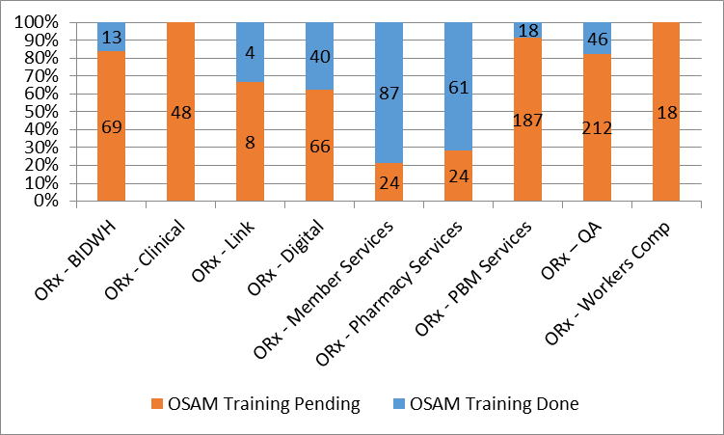
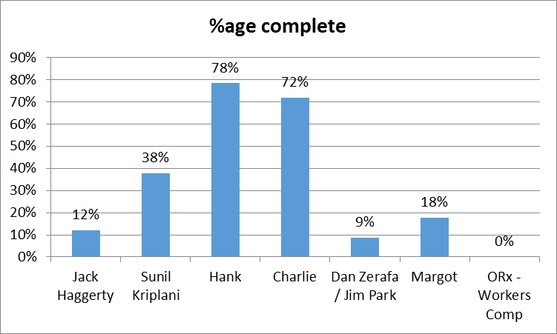
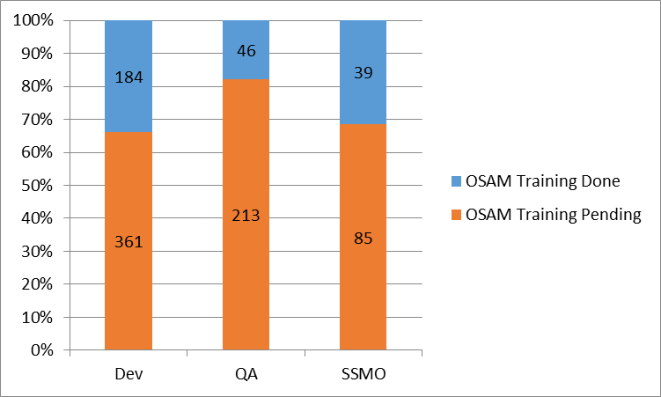
OGS OSAM Training
28% of overall organization is OSAM trained
Remaining is being planned in line with latest roadmap by leaders

Slide 34
OGS QA to QE Transformation
Annotation
Current state is based on trainings imparted till mid of Dec’ 17 .
Reconciliation QE penetration in-progress on trainings imparted
Align QE transformation with Agile transformation roadmap
Continue trainings meet goals
Utilization of QE resources so far:
In-sprint/System test automation, and regression automation
Establishing practices of ATDD/Cucumber frameworks
ATDD implementation in Member portals and BriovaRx applications
Agile ATDD
Penetration Acceptance Tests

Slide 35
Application level QE penetration
Application: | % QE
Navigator | 39%
Webservices | 47%
IVR | 5%
PAS | 8%
IRIS | 15%
Member Portals | 48%
Mobile | 17%
BriovaRx | 40%
DW/BI | 5%
RxClaim (Base/BK1/BK2/Medicaid Encounter) | 25%
RxBuilder | 38%
PAMSMagenta | 33%
Scriptconnect/Rxlink | 5%
RxMax | 5%
CPP - Clinical | 67%

Slide 36
Appendix
Matt Mosher

